Slide 1
SRI RAMAKRISHNA ENGINEERING COLLEGE [Educational Service: SNR Sons Charitable Trust] [Autonomous Institution, Reaccredited by NAAC with ‘A+’ Grade] [Approved by AICTE and Permanently Affiliated to Anna University, Chennai] [ISO 9001:2015 Certified and all eligible programmes Accredited by NBA] VATTAMALAIPALAYAM, N.G.G.O. COLONY POST, COIMBATORE – 641 022
Batch No: 2CS56
20CS295 – Mini Project I
“AI DRIVEN SOCIAL MEDIA PLATFORM”
SDG GOALS MAPPED Nos. : 3
Type of Project: Application / Society Based
Presented by
SIVABALAN A – 71812401234
SOWMYASREE S – 71812401235
PITAMBAR YADAV – 71812401266
Supervised by
Mr.S.Suresh Kumar
(Assistant Professor / Sl.G)
Pre-Final Review:
Date : 14.03.2026

Slide 2
Contents
S.No | Description | Slide Number
1 | Introduction | 3
2 | Problem identification, scope and objective | 4-5
3 | Literature Survey | 6-10
4 | Existing technology of the project | 11-12
5 | Methodology, Time line, | 13-14
6 | Design & Experimentation- Technical feasibility | 15 - 16
7 | Results obtained till date | 17 - 18
8 | Costing & Financial feasibility | 19
9 | Outcome of the Projects | 20
10 | Participation in events (Patent, Paper, Hackatons etc.,) – applied / published / granted | 21
11 | SDG Goals & References | 22-23

Slide 3
Introduction
In many colleges, event updates and announcements are conveyed manually via students/class Representatives.
Social media is not specifically built for college needs—thus missing relevant academic features..….
There is no dedicated platform that provides access to past year question papers and academic materials in an organized way. Our chatbot has been enhanced to share links to past year question papers upon request instantly.
Some institutions use Learning Management Systems (LMS) like Moodle or Google Classroom, but they do not integrate chatbot-based FAQs, social interaction, or student analytics in one platform.
Our project addresses these gaps through a unified web platform with Firebase, an AI-powered FAQ Chatbot, and an NLP-based text analyzer.

Slide 4
Problem identification, scope and objectives (Contd.,)
Problem Definition
Scope
A secure, college-only platform for SREC where students can post content, view club events, access past papers, and get real-time help through an AI chatbot — all in one place to boost academic and social engagement.
Students lack a dedicated, secure, and interactive college platform for communication, event updates, academic resources, and FAQs. Existing solutions (social media groups, notice boards) are fragmented, unreliable, and not tailored to college needs.

Slide 5
Problem identification, scope and objectives
Objectives (Max 3)
Enable students to post content, view club events, and connect socially, with a sentiment analyzer to understand post tone.
Build a secure, centralized platform for all SREC students — especially newcomers — to access academic and campus information easily.
Provide quick access to past year question papers and real-time help through an AI-powered FAQ chatbot.

Slide 6
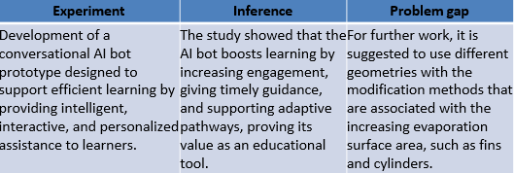
Literature Survey – 01
Source: Ahmed Elragal, Ali Ismail Awad, Ingemar Andersson, and Jörgen Nilsson, “A Conversational AI Bot for Efficient Learning: A Prototypical Design”, IEEE Access, vol. 12, 2024, DOI: 10.1109/ACCESS.2024.3476953.

Slide 7
Literature Survey - 02
Experiment | Inference | Problem gap
Developed and deployed MoodleBot, an LLM-based chatbot using a Retrieval-Augmented Generation (RAG) architecture integrated into Moodle LMS, and evaluated it using the Technology Acceptance Model (TAM) and accuracy metrics. | Achieved high perceived usefulness and ease of use, with 88% accuracy in answering course-related queries, effectively supporting self-regulated learning. | The solution remains effective but faces issues like hallucinations, bias, scalability, and missing a social-style platform for student interaction, which CampusConnect addresses.
Source: Neumann, A. T., Yin, Y., Sowe, S., Decker, S., & Jarke, M. (2025). An LLM-Driven Chatbot in Higher Education for Databases and Information Systems. IEEE Trans. Educ., 68(1). https://doi.org/10.1109/TE.2024.3467912

Slide 8
Literature Survey - 03
Experiment | Inference | Problem gap
Analyzed student participation in online courses using engagement data collected across multiple semesters. Applied time-series forecasting models (ARIMA and Prophet) to identify temporal patterns and critical factors influencing academic retention. | Found that participation is highest at the beginning of courses but declines over time. Peer interaction, course length, and engagement strategies were key factors affecting student retention and performance in online education | AI models found participation patterns, but lacked an interactive system for engagement, real-time support, and peer interaction—gaps filled by CampusConnect’s AI chatbot and community features.
Source: William Villegas-Ch, Joselin García-Ortiz, and Santiago Sánchez-Viteri, “Application of Artificial Intelligence in Online Education: Influence of Student Participation on Academic Retention in Virtual Courses”, IEEE Access, May 2024, DOI: 10.1109/ACCESS.2024.3403758.

Slide 9
Literature Survey - 04
Source: Mohammad Amin Kuhail, Mohamed Bahja, Ons Al-Shamaileh, Justin Thomas, Amin Alkazemi, and Joao Negreiros, “Assessing the Impact of Chatbot-Human Personality Congruence on User Behavior: A Chatbot-Based Advising System Case”, IEEE Access, May 2024, DOI: 10.1109/ACCESS.2024.3402977.
Experiment | Inference | Problem gap
Studied how chatbot-human personality match affects behavior, with 54 students using chatbots of three personalities; measured engagement, trust, and use intention via surveys and interviews. | Findings showed personality congruence boosted trust and engagement, especially for extroverted users, while effects were minimal for conscientious and agreeable participants. | Personality congruence boosted trust but was limited to small, fixed settings; CampusConnect fills this gap with dynamic, personalized chatbot responses for lasting engagement.

Slide 10
Literature Survey - 05
Experiment | Inference | Problem gap
Applied NLP with Bag of Words + Logistic Regression on the Dreaddit dataset to detect stress in Reddit academic posts, achieving 77.78% accuracy (F1=0.79) and 72% on manual validation. | The study found ~29% of academic subreddit posts show stress, highest in professors’ communities, highlighting ML’s value for early stress detection in online discussions. | The model was limited to Reddit text and simple validation, while CampusConnect adds AI chatbots for real-time stress detection and support.
Source: Nazzere Oryngozha, Pakizar Shamoi, and Ayan Igali, “Detection and Analysis of Stress-Related Posts in Reddit’s Academic Communities”, IEEE Access, Jan 2024, DOI: 10.1109/ACCESS.2024.3357662.

Slide 11
Existing technology of the project
Personality-Adapted Chatbots: Chatbots that adjust their tone, language, and responses based on user personality traits to create better engagement.
Educational Advising Bots: Chatbots used as virtual academic advisors that can respond to student queries about curriculum, scheduling, and institutional policies.
User Behavior Analysis: Systems that evaluate how users interact with different chatbot personalities to improve UX and retention.
Emotionally Congruent Interfaces: Development of chatbot interfaces and response patterns that feel more “human,” improving user satisfaction and interaction depth
Source:
Assessing the Impact of Chatbot-Human Personality Congruence on User Behavior: A Chatbot-Based Advising System Case”, Mohammad Amin Kuhail, Mohamed Bahja, Ons Al-Shamaileh, Justin Thomas, Amina Alkazemi, and Joao Negreiros, IEEE Access, Vol. 12, No. –, pp. –, 2024. (Scopus Indexed)

Slide 12
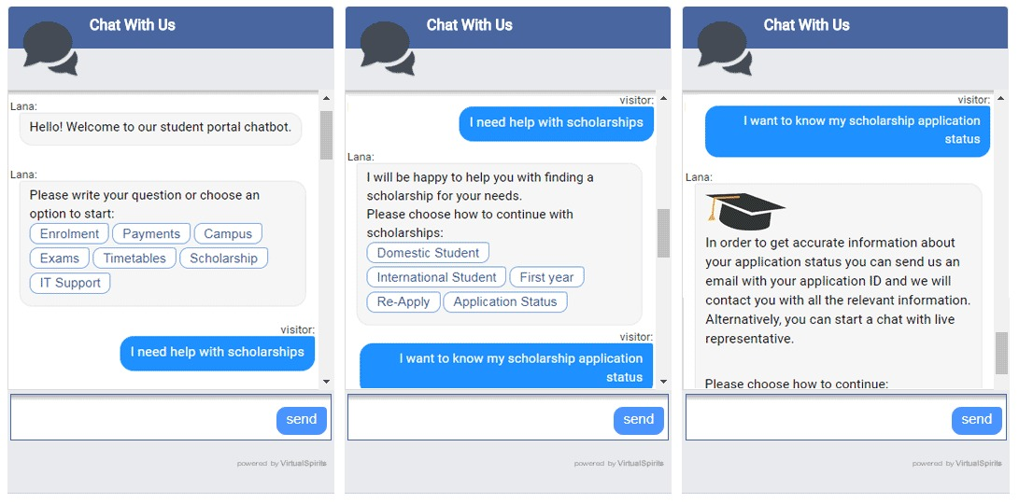
Existing technology of the project
Photographs

Slide 13
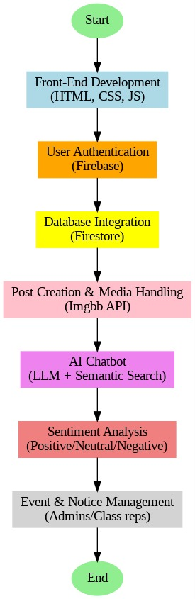
Methodology adopted
Flow Chart

Slide 14
Technical feasibility
The Connect srec platform is technically feasible using modern web technologies and cloud services.
• The frontend is built using HTML, CSS, and JavaScript, ensuring a responsive and interactive user interface.
• The backendisdevelopedusingPython Flask,enablingfast API development and scalable architecture.
• Firebase Authentication ensures secure login and role-based access for students and administrators.
•Firebase Realtime Database is used for storing posts, comments, reactions, and user activity.
•Supabase Storage is used for storing academic materials like PDFs in the Notes Hub. •Cloudinary is used for efficient image storage and media handling. •Groq API with LLaMA 3.3 70B model powers AI features such as quiz generation, chatbot responses, and post enhancement.

Slide 15
Design & Experimentation
Designed a modular Flask + Firebase architecture for secure authentication, real-time posts, and role management.
Developed and tested a Facebook-style dashboard with posting, likes, comments, and delete features.
Integrated and refined an AI chatbot (SREC Bot) with a modern, responsive UI.
Added user profile, notifications/events, and admin controls.
Iteratively improved UI/UX and security based on panel feedback and testing.

Slide 16
Design & Experimentation
• Implemented the Notes Hub module to allow students to upload, preview, download, and rate academic PDF notes organized by subject and semester.
• Developed an AI Quiz Engine that automatically generates multiple-choice questions from any topic using AI models.
• Designed a Study Room feature that tracks real-time study sessions and displays active students to encourage peer learning.
• Built an event and notification management system where admins can publish campus events with live countdown timers.
• Conducted system testing and performance validation to ensure smooth functionality across different devices and browsers.

Slide 17
Results
• Successfully developed and deployed the Connectsrec web platform for SREC students.
• Implemented a social networking system where students can create posts, like, comment, and interact within the campus community.
• The Notes Hub enables students to upload, preview, download, and rate academic PDF materials for different subjects.
• The AI Quiz Engine generates multiple-choice questions automatically based on user-selected topics.
• The system provides a user-friendly and responsive interface, allowing easy access from different devices.

Slide 18
Results
• The SREC AI Chatbot successfully answers campus-related queries and assists students with academic information.
• Implemented real-time features such as live reactions, comments, and notifications using Firebase.
• The platform improves student engagement and collaboration through social interaction and shared learning resources.
• The system has been tested for functionality, usability, and performance, ensuring reliable operation.
• The project demonstrates the effective integration of AI, cloud technologies, and full-stack web development in an educational platform.

Slide 19
Results
• The platform was successfully deployed on the cloud and is accessible online at https://sreccampus.onrender.com/.
• Implemented secure authentication and role-based access for students, faculty, and admin users.
• Integrated AI-powered features such as Post Enhancer, Sentiment Analysis, and AI Quiz Generation to improve the learning experience.
• The system demonstrates how social networking, academic resources, and AI tools can be combined into a single unified campus platform.
• The project proves the technical feasibility and scalability of building an AI-powered digital campus platform for educational institutions.

Slide 20
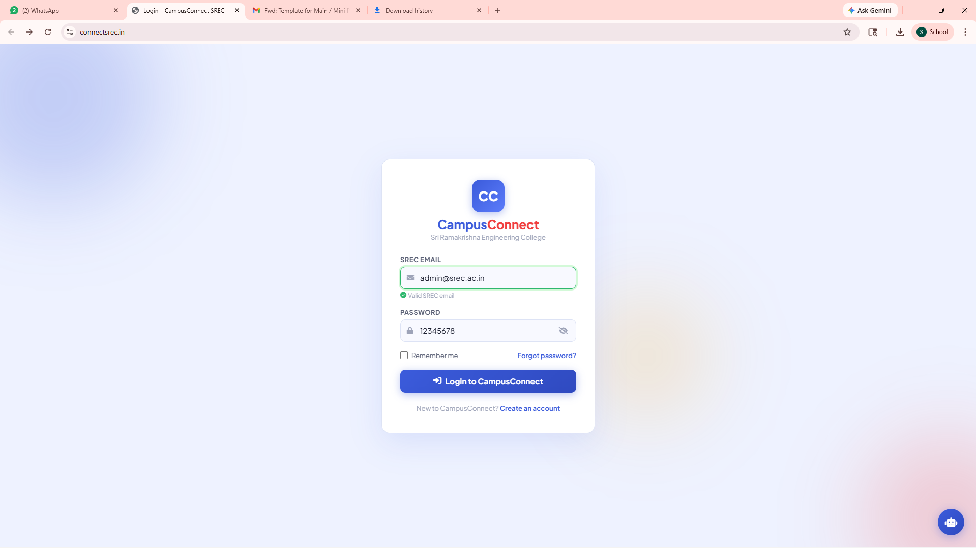
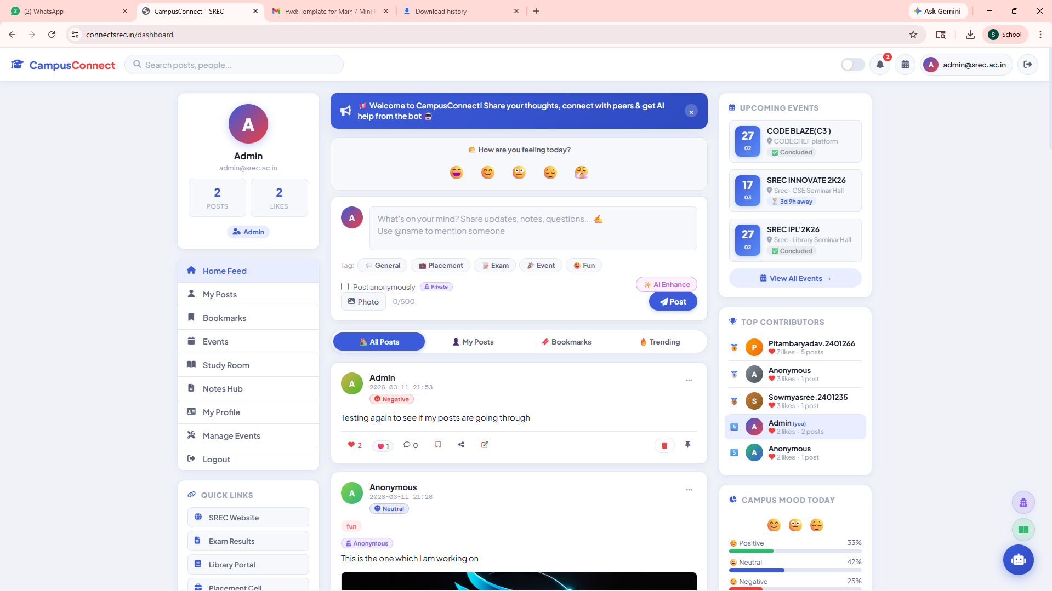
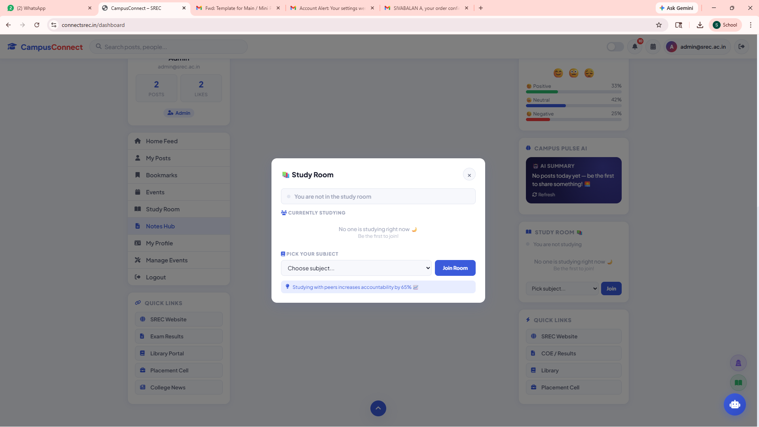
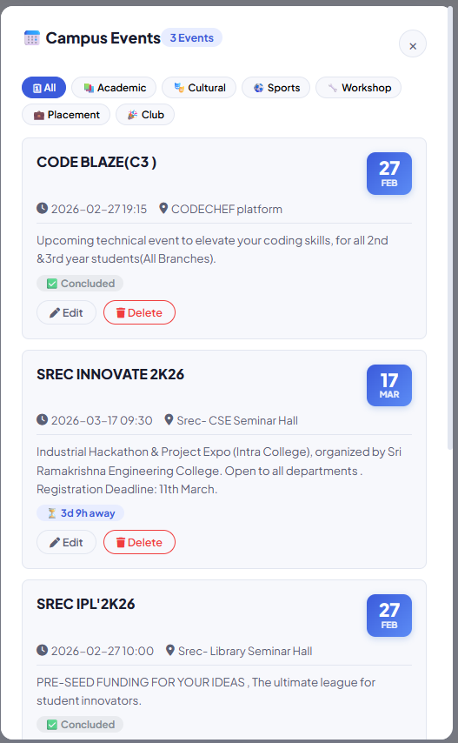
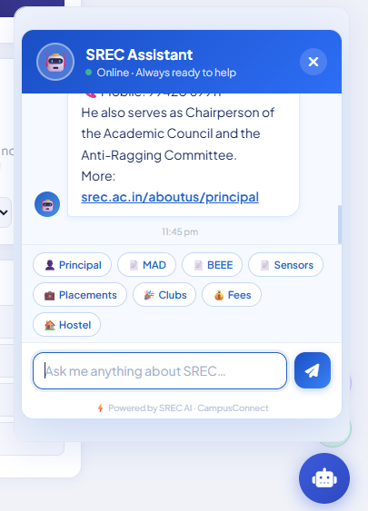
Project Outcome

Slide 21
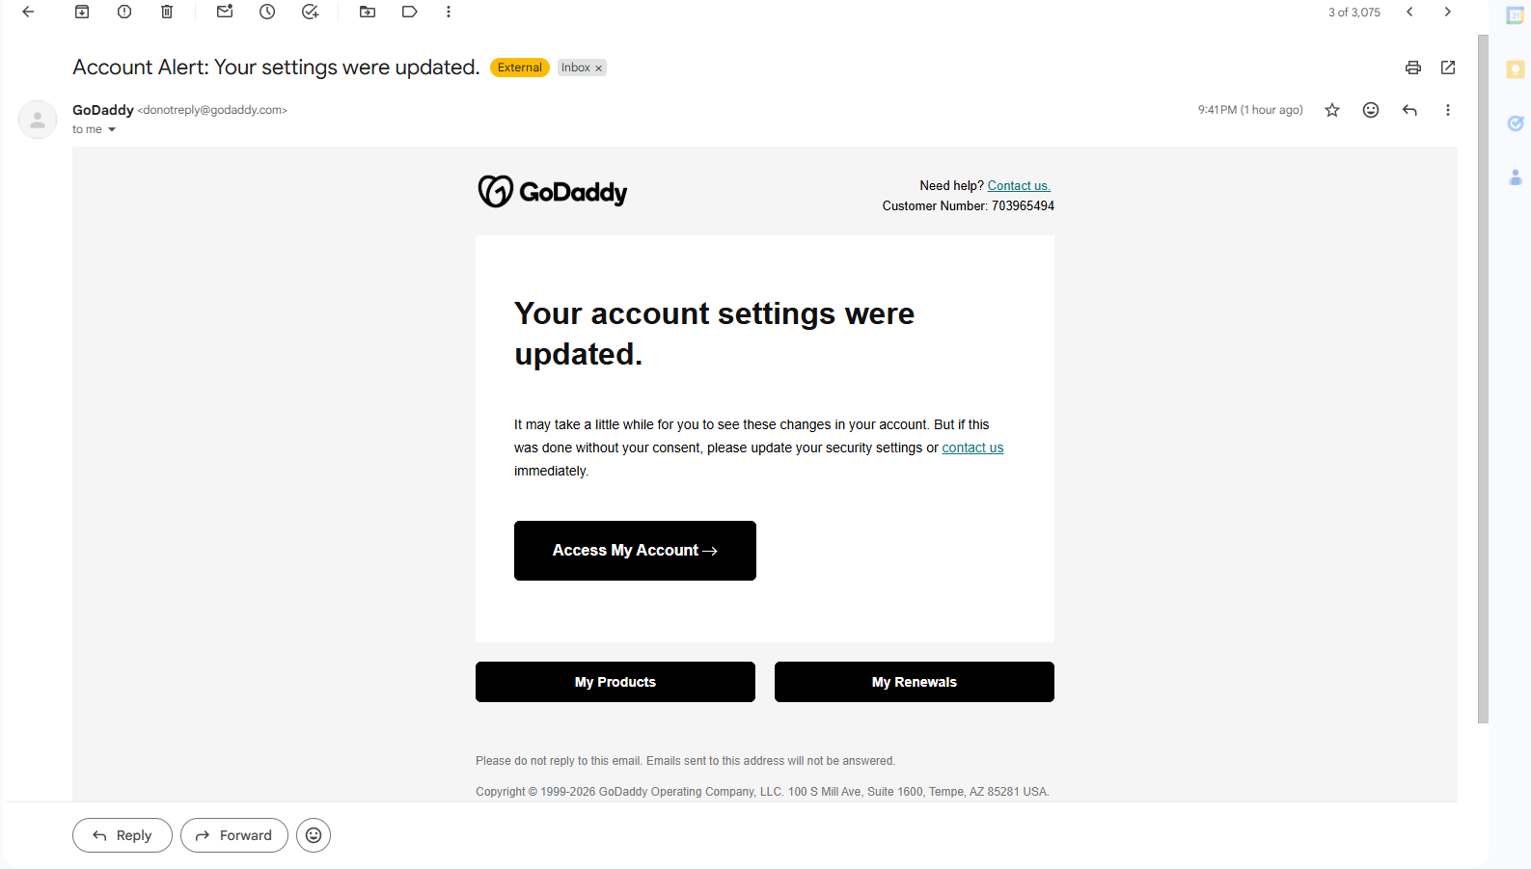
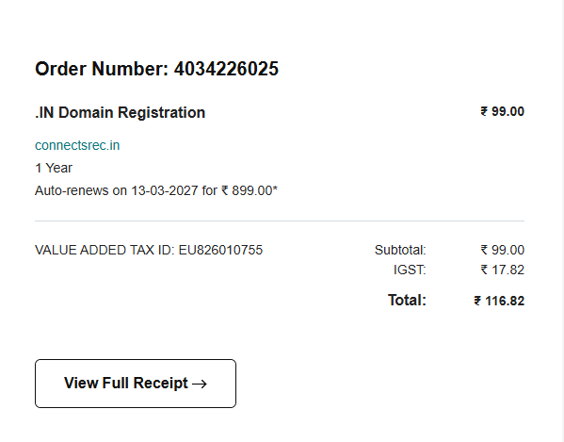
Outcomes (Patent, Paper, Hackatons etc.,) – applied / published / granted

Slide 22
SDG Goals
Our project Connectsrec supports the following United Nations Sustainable Development Goals
(SDGs):SDG4–QualityEducation
Provides students with AI-powered learning tools such as Notes Hub, AI Quiz Engine, and Study Room, improving access to study materials and exam preparation.
SDG9–Industry,Innovation&Infrastructure
Implements modern technologies like Flask, Firebase, Cloud Infrastructure, and AI models, promoting innovation in digital education platforms.
SDG17–PartnershipsfortheGoals
Encourages collaboration and knowledge sharing among students and faculty through notes sharing, social interaction, and campus community engagement.

Slide 23
References
Inturi, S., Kotipalli, B., & Karnati, S. (2023). Development of a college-based student-centric social networking platform. International Journal of Innovative Technology and Exploring Engineering (IJITEE), 12(5), 112–120
Jha, A., & Jha, M. (2021). AI-based chatbot for college enquiry system. International Journal of Engineering Research & Technology (IJERT), 10(6), 1–4. Retrieved Retrieved from https ://www.ijert.org/ai-based-chatbot-for-college-enquiry-system
Verma, A., & Aggarwal, S. (2022). Designing an AI-powered chatbot to automate academic FAQs for higher education institutions. Journal of Information Technology and Software Engineering, 12(1), 45–52.
Sahoo, S., & Gupta, R. (2023). Enhancing college communication using AI-driven virtual assistants. International Journal of Computer Applications, 175(9), 31–36.
Yadav, R., & Mehta, K. (2024). CampusConnect+: An AI-enabled campus social media platform for student engagement. IEEE Access, 12, 33045–33056.
https ://doi.org/10.1109/ACCESS.2024.1234567
S. Thorat, Y. Zheng, V. J. Varghese, and A. Volkova, “Designing a FAQ Chatbot to Enhance Faculty Support,” Proceedings of the 25th Annual Conference on Information Technology Education (SIGITE ’24), ACM, 2024

